Slide 1

PP 297 – 001: Stata for Policy Analysts
Welcome!
Feel free to come up and ask questions on anything!
Otherwise, open Stata and download the do-files and data for the session
Take your nametag from the stack going around
Notes:
12:00 – 12:10

Slide 2
Problem Set #2 Posted
Due next Monday (2/25) by midnight
Discussion forum on bCourses for frequent questions
Will apply all concepts prior to today’s session:
Variable management (gen, replace, egen)
t-tests
Correlation
Regressions
Scatterplots
Questions on Problem Set
Labels
Notes:
12:10 – 12:12

Slide 3
Office Hours
Tuesdays and Thursdays 9 – 10 am in GSPP Computer Lab
Happy to provide:
Stata help on our problem sets
Stata help on PP 240B problem sets
Empirical research questions (IPA’s included!)
Data science help (including other programs)
Advice on seeking employment with the US Government
Notes:
12:12-12:13

Slide 4
Comments or Suggestions?
Any feedback, comments, general statements?
Expectations from the Stata course?
Expectations from our Problem Sets?
Suggestions for organizing materials?
Notes:
12:13-12:15

Slide 5
Today’s Roadmap
Stored Statistics
e-class
r-class
Outputting Regression Tables (estout & outreg2)
Predicted Values
Visualization II
Histograms
Bar Graphs
Line Graphs
Log Transformations and Plots
Notes:
12:15

Slide 6
Stored Statistics
e() and r()
Notes:
12:15

Slide 7

Have you ever wanted to not copy/paste?
Now you can!
Notes:
12:15

Slide 8
Stored Results
The results of calculations are stored by many Stata commands so that they can be easily accessed and used later
Stata commands are divided into two groups for the purposes of storage:
e-class: estimation commands such as regress, logistic, etc., that fit statistical models. Such estimation results stay around until the next model is fit. Results are returned in e()
r-class: general commands such as summarize. Results are returned in r()
Notes:
12:16

Slide 9
Stored Statistics (e-class)
Let’s go back to one of the regressions from your problem set (testing the difference between the two groups)
reg unemploy_prop_both2018 perc_refugees2018
Now let’s display the results stored in e()
ereturn list
display e(N)
display e(r2)
Notes:
12:17

Slide 10
Stored Statistics (e-class)
Coefficients and standard errors are a special case and can be accessed with either matrix list e(b) or display _b[varname] and display _se[varname]
Ex.: display _b[perc_refugees2018]
Constants can be accessed in a similar way
Ex.: display _b[_cons]
Ex.: display _se[_cons]
Notes:
12:20

Slide 11
Stored Statistics (r-class)
1) Let’s try doing a detailed summary of the perc_refugees2018 variable
sum perc_refugees2018, d
2) Once that’s done, all of the results from the command are stored in r(). We can display those results with:
return list
The name of each result is how you refer to it in Stata…
Notes:
12:21

Slide 12
Stored Statistics (r-class)
There’s a ton we can do with these stored results
You can use the display command to find the range
display r(max) – r(min)
Maybe we want to keep a certain value for later use
gen perc_refugees_mean = .
replace perc_refugees_mean = r(mean)
This will record the mean in a new variable in the data browser
Notes:
12:22

Slide 13
Stored Statistics (r-class)
If we want to then calculate a percent difference from the mean
There’s a great Stata trick to refer to that line in an expression!
gen refugee_mean_diff = .
replace refugee_mean_diff = ///
(perc_refugees2018 – perc_refugees_mean) / perc_refugees2018
Notes:
12:23

Slide 14
outreg2 & estout
Notes:
12:25

Slide 15
Install estout
If you have not already done so, please enter the following line into your command window (it installs the estout commands package)
ssc install estout, replace
Notes:
12:25

Slide 16
esttab
The esttab will produce a publication-friendly table based on estimation commands that are stored in r()
Step 1: Enter a regression (any regression)
reg unemploy_prop_both2018 perc_refugees2018
Step 2: Enter esttab
Step 3: Profit…with a slick regression table
Notes:
12:26

Slide 17
Exporting your esttab results
You can export your esttab results to Excel or Word
Excel: esttab using test.csv
Word: esttab using test.rtf
Note: the file extension (.csv vs .rtf) is the distinguishing feature
You can click to open the file directly from the Stata window
Notes:
12:28

Slide 18
eststo
What if you want to add multiple models to your output? You can employ the eststo command
1) First model -- eststo: reg cancerlung smoke
2) Second model – eststo: reg cancerlung smoke active
3) esttab
This will display an (almost) publication ready regression table
Notes:
12:30

Slide 19
Notes:
12:31

Slide 20
Clearing the results for esttab
If you’ve started to add models to your esttab output, but want to start over, you can clear your results
estimate clear
You can check that it worked by using the estout command – this displays what esttab processes in the background
Notes:
12:32

Slide 21
Formatting your esttab output
You can format it to look uber-professional in either Word or Excel
I recommend the second-half of this video (watch later!): https://www.youtube.com/watch?v=TGPLD6NFrlQ
Notes:
12:33

Slide 22
Useful esttab options
esttab, se replaces the t-statistics with standard errors
esttab, ar replaces the r^2 with the adj. r^2
esttab, nostar suppresses the sig. stars
See help file for titling and labeling options
Notes:
12:34

Slide 23
estpost (bonus)
Use with e-class commands like summarize (see the estpost help file for a full list)
Note: If you’ve been using eststo with regressions, you should start by doing estimate clear
1) estpost summarize unemploy_prop_both2018 this will display where each estimation is stored
2) esttab, cells(“count mean sd min max”) use the cells option on esttab to specify which results to display
Notes:
12:35

Slide 24
Just to mention it…
outreg2 is another command that accomplishes basically the same as the estout package
I included a guide in the do-file, but as you can probably tell it’s more complicated
The biggest difference is rather than using something like eststo to build a model prior to export, outreg2 appends models successively onto an external file
I prefer estout but you may prefer the outreg2 formatting
Notes:
12:37

Slide 25
Predicted Values
Notes:
12:38

Slide 26
Predicted Values
Regression models can be used to make predictions about the dependent variable (output) using the independent variables (input)
Making predictions in Stata is easy
After running a regression model, use:
predict [new_var] [if] [in]
Notes:
12:38

Slide 27
Predicted Values
predict [new_var] [if] [in]
Predict creates a new variable of the predicted values, which you can treat like any other data
Do-File:
Challenge 1 – Create a variable of predicted values
Challenge 2 – Summarize your predictions
Question 1 – Are these “good” predictions?
Notes:
12:40

Slide 28
Notes:
12:45

Slide 29
Predicted Values
predict unemploy_predictions if surface_area > 30
No, those are horrible predictions
Predictions are only as good as the underlying regression model
Often you want to make predictions on “out-of-sample” data, for a set of independent variable values not in your original data
Notes:
12:45

Slide 30
Data Visualization II
Distribution: Histograms and Density Plots
Graphs: Bar and Line
Notes:
12:47

Slide 31
Histograms
Histograms are used to visually represent the frequency distribution of numeric data
Can be applied to continuous or discrete variables
histogram [varname] histogram of a variable
Challenge 3 – Make a histogram for unemployment in 2005
Notes:
12:47

Slide 32
Notes:
12:49

Slide 33
Histograms
hist [varname], discrete option to specify that the data is discrete (falls into specific countable categories)
hist [varname], bin(#) specifies the number of bins (for continuous variables)
, density | , fraction | , frequency | , percent are all options to decide the format by which your y-axis is displayed
Notes:
12:50

Slide 34
Histograms
Histograms can be overlaid like other graphs, but Stata doesn’t have transparency options until Stata 15
Otherwise, style options are standard for graphs
You can also overlay distributions onto a histogram with options normal or kdensity
Notes:
12:52

Slide 35
Notes:
12:53

Slide 36
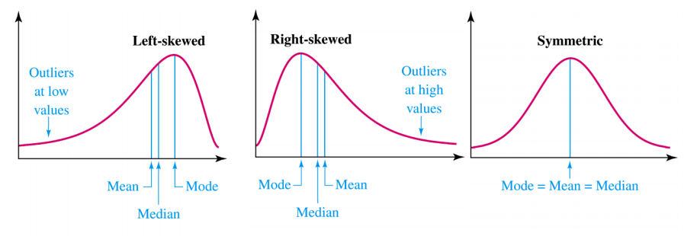
Skew and Modality
Notes:
12:55

Slide 37
Bar Graphs
Live Code Example:
sort unemploy_rate_both2005
graph bar unemploy_rate_both2005 in 205/209, over(regioncode)
list unemploy_rate_both2005 in -5/L
list unemploy_rate_both2005 in -5/L if unemploy_rate_both2005 != .
list unemploy_rate_both2005 in -10/L if unemploy_rate_both2005 != .
graph bar unemploy_rate_both2005 in -10/L if unemploy_rate_both2005 !=. , over(regioncode)
Notes:
12:57

Slide 38
Notes:
1:05

Slide 39
Notes:
1:10

Slide 40
Line Graphs
Line graphs are useful to show large amounts of data or compare several observations over time
However, they can be a bit hard to make if your data isn’t in the correct format…
Challenge 4 – Make a line graph showing the change in unemployment from 2005 to 2010 for all countries
twoway line unemploy_rate_both2005 unemploy_rate_both2010
Notes:
1:12

Slide 41
Notes:
1:13

Slide 42
Line Graphs
Live Code Example:
keep regioncode unemploy_rate_both*
reshape long unemploy_rate_both, i(regioncode) j(year)
sort regioncode year
Challenge 5 – Make a line graph of unemployment rates in Brazil
Notes:
1:14

Slide 43
Notes:
1:15

Slide 44
Notes:
1:18

Slide 45
Notes:
1:20

Slide 46
Notes:
1:22

Slide 47
Log Transformations and Plots
Notes:
1:23

Slide 48
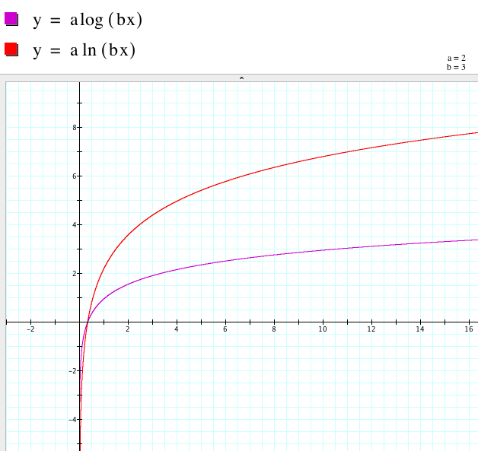
Natural Log Transformations
Challenge 5 – Create new variables for gdppercap and lifeexp that are “transformed” by natural logs
Notes:
1:23

Slide 49
Notes:
1:25

Slide 50
How do we interpret a log transformed regression output?
Notes:
1:25

Slide 51
Notes:
1:28

Slide 52
Questions?
Notes:
1:28

Slide 53

Please return nametags
Have a great day!
Notes:
1:30

